Slide 1
Week 4 Activity 1: Async/Await
Transcript Server: Create a student, then post their grades
Create a new student in the transcript server then…
Assign several grades for that student then…
Fetch the transcript for that student Your task will be to take a list of students with a list of grades, post them, and return all of the resulting transcripts
await client.addStudent('test student');
await client.addGrade(studentID, 'demo course', 100);
await client.getTranscript(studentID)
Download the activity (includes instructions in README.md): Linked from course webpage for week 4, or at https://bit.ly/34GbcN6
Notes:
For this activity, you will work with an API client that we will provide to interact with our transcript server.
<read slide>
Next lesson will dive into REST and how this server works.

Slide 2
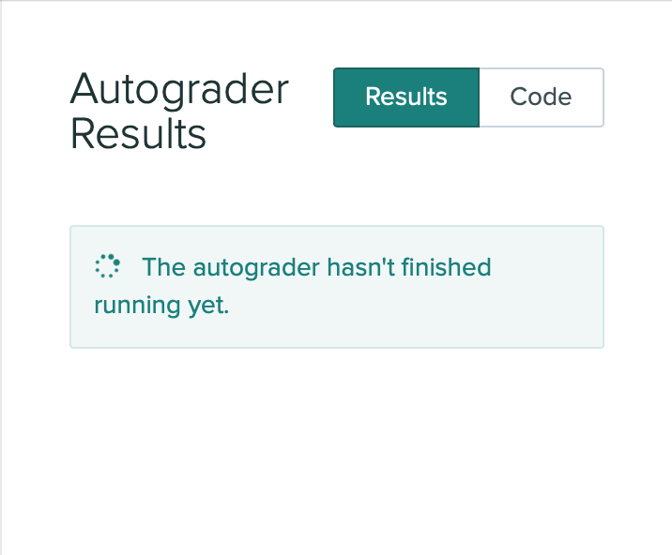
Week 4 Activity 2: Testing and Debugging
Learning Objectives for this activity:
Practice applying asynchronous programming concepts: promises, async/await
Have an experience working with the Jest testing framework
Your task:
Write “black box” test cases for the transcript server that we worked with in Activity 1 this week
Download the activity at: https://bit.ly/3GskDgp

